Slide 1
TAILORED SAMPLE RECOMMENDATIONS FOR MUSIC PRODUCERS

Slide 2

What is Sampling?
Notes:
http://www.marsbands.com/2011/10/97-million-and-counting/
(nearly 100 million recorded songs!)

Slide 3
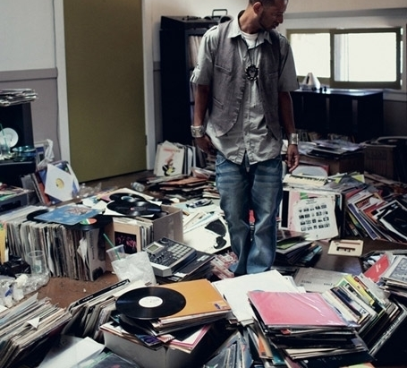
recommenders help USERS Choose From Many options
Notes:
https://datajobs.com/data-science-repo/Recommender-Systems-%5BNetflix%5D.pdf

Slide 4
Types of Recommendation Systems
Content Filtering
Collaborative Filtering
Explicit Feedback
Implicit Feedback

Slide 6
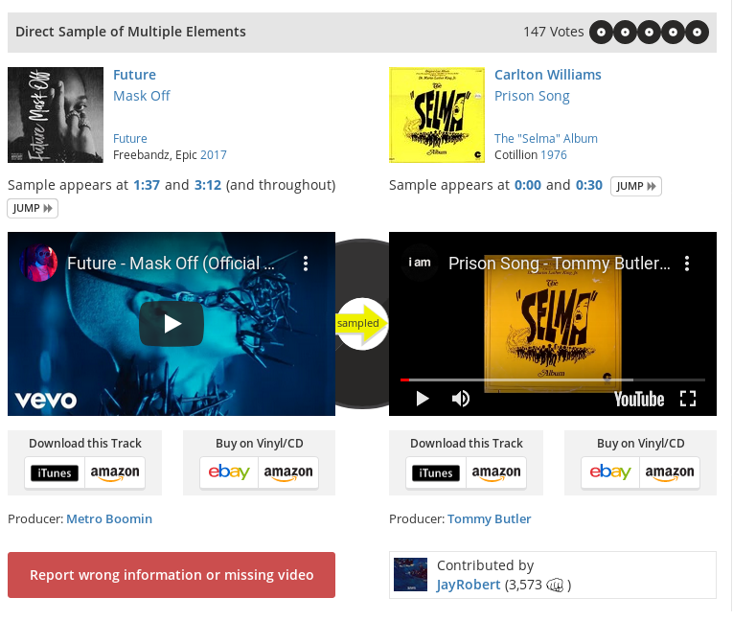
Data Collection

Slide 7

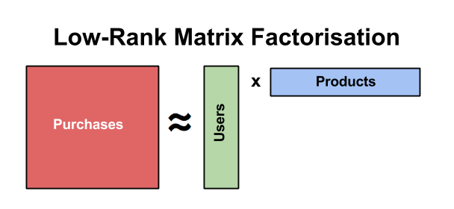
Sampled Artists
Sampled Artists
1 0 0 0 0 0 0 0 5 9 0 0 3 0 0 0 2 0 0 1 0 0 0 0 0 0 1 0 4 0 0 0 0 2 0 3 0 0 0 0 0 0 1 0 1 0 8 7 0 1 1 0 1 0
1 0 0 0 0 0 0 0 1 1 0 0 1 0 0 0 1 0 0 1 0 0 0 0 0 0 1 0 1 0 0 0 0 1 0 1 0 0 0 0 0 0 1 0 1 0 1 1 0 1 1 0 1 0
Producer Matrix
Sampled Artist Matrix
Producers

Slide 8
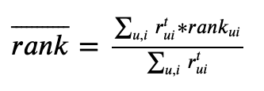
Ranking the Model
Notes:
The rank score ranges from 0 to 1, with lower scores being better.
A rank score of 0.5 reflects a model no better than random.
Model performance is compared to a baseline of simply recommending the most popular artists.

Slide 9
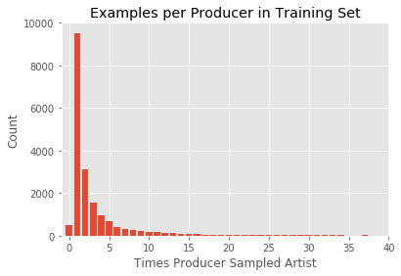
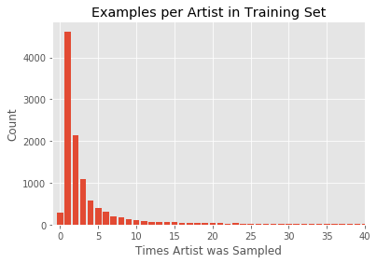
Model Performance Hampered by Sparsity of Data
Notes:
Sparsity of data means few examples to train on.

Slide 10
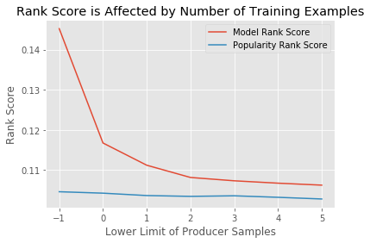
Notes:
Therefore, I limited my dataset to producers with greater than 5 examples.

Slide 11
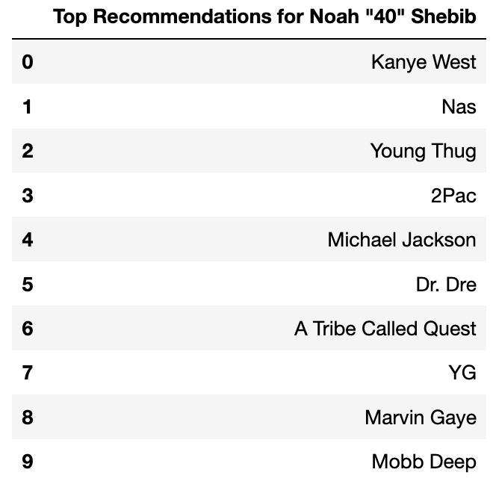
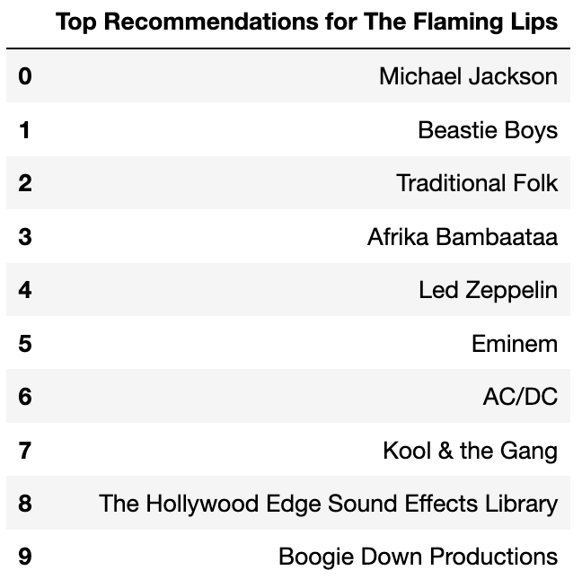
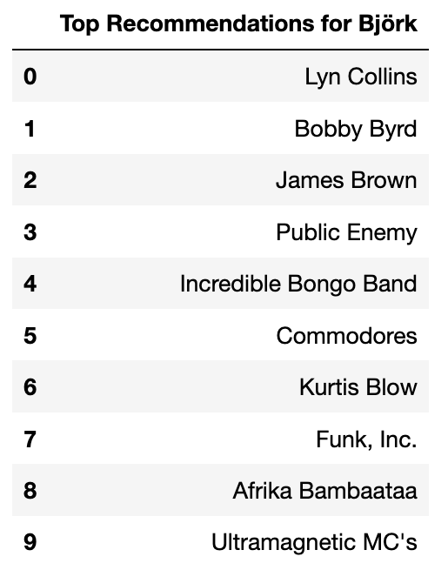
Recommendations Are Tailored BY Genre
Hip Hop
Rock
Alternative

Slide 12
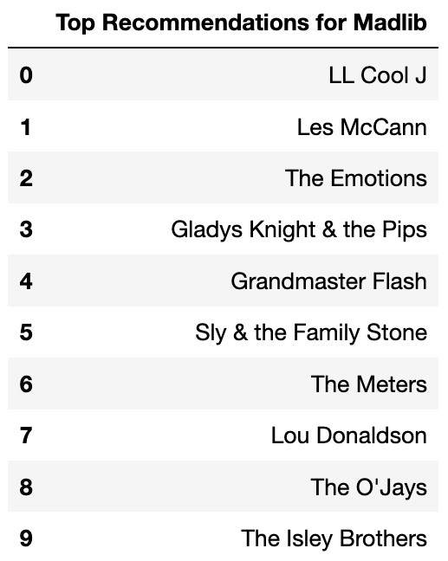
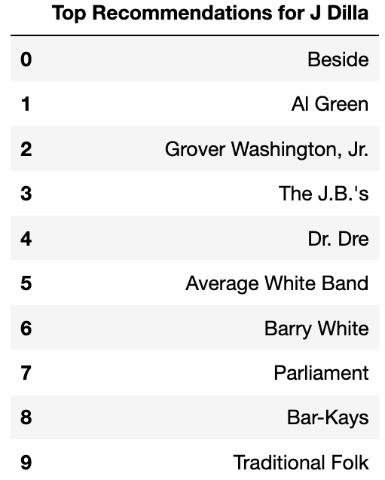
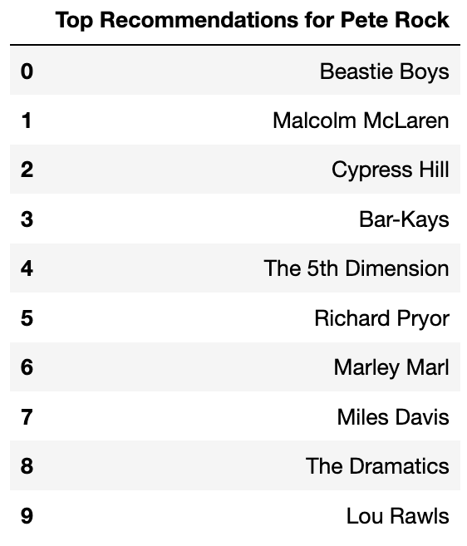
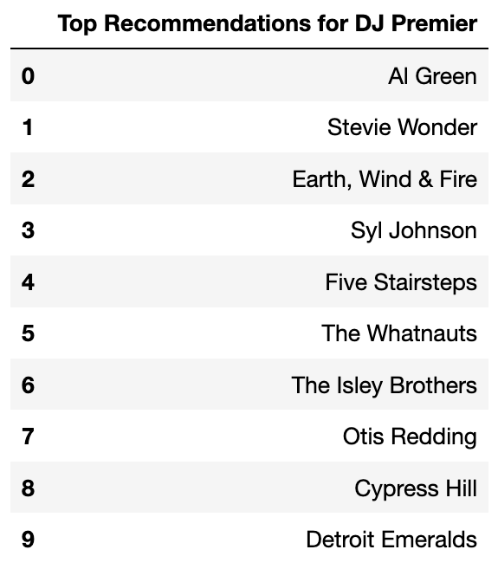
Recommendations Are better tailored FOR Producers with more samples
Notes:
These are the top 4 producers in the dataset, and we can see that their recommendations are very unique to them.

Slide 13
Conclusion and Future steps
My model scores much better than random and is similar to popularity.
However, many of its’ recommendations are lacking in diversity.
Furthermore, it is not effective for producers with few sampled artists.
A multi-level ensemble recommender with content filtering may help to address these problems.

Slide 14
Finding similar producers
His brother
His protege
Worked together

